Slide 1

Reinforcement learning robot
UPDATE!
An experiment in self-taught mobility
Gene Olafsen

Slide 2
introduction
This project will construct both a self-contained training environment and robot with an articulated appendage with which the robot will learn to use to move in a specific direction.
The system will employ software that will utilize a reward to teach the robot which actions result in movement in the desired direction.

Slide 3
origin
Scott presented such a 'robot' learning in a virtual environment during a Q-Learning discussion a few months back.
The presentation described a reward/penalty system in which the agent (robot) learned to move through a trial and error process.
The Metrowest Boston Machine Learning Group had great success in developing, training and demonstrating a model self-driving car project.

Slide 4
Video proof
https://ibm.ent.box.com/s/jkzxleqk1775stk1cyt2mi4jjeq7hy1u/file/385071978673

Slide 5
Why?
The physical 'embodiment' of machine learning systems is very engaging (and entertaining).
Most reinforcement robot examples transfer a 'virtually' trained model into a physical machine.
Building Something = Learning Something
Construction of reliable hardware
Latency between the model making a decision and the 'machine' taking action
Machine calibration between uses (sensors, servos, etc.)

Slide 6
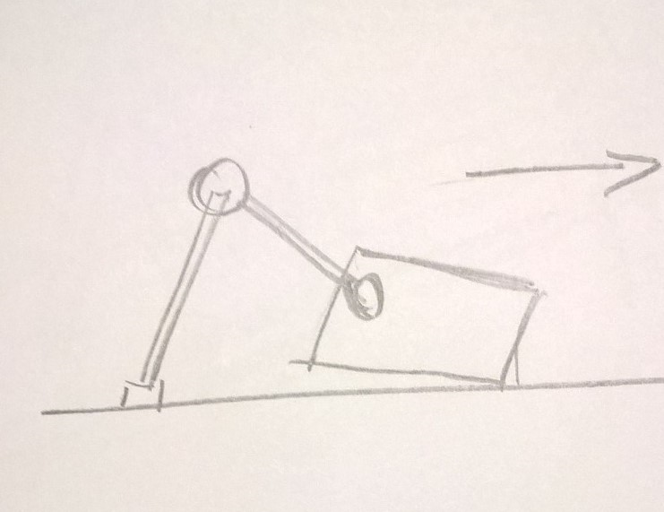
sketch
The robot will have an appendage that it will use to push it in the specified direction.
Note: The robot is expected to be lifted by the appendage as it learns to move.

Slide 7
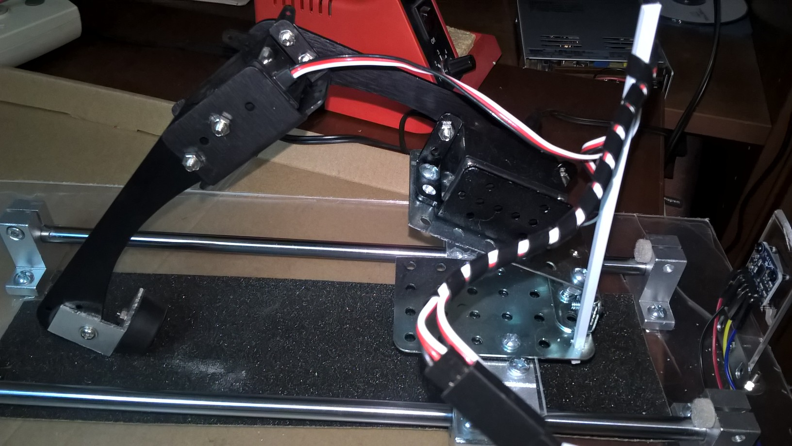
Physical Robot
The robot closely matches the sketch.
Two servos and a hinged platform.

Slide 8
Design constraints
The robot and training environment must be robust, self-contained, and easy to pick up and transport to demonstrate at meetings.
It is expected that the training mode does not require supervision. As a reinforcement learning system the demonstrator should be 'turned on' and 'learn' in an environment that can handle all learning attempt outcomes.
The system allows multiple learned 'plans' to be demonstrated.

Slide 9
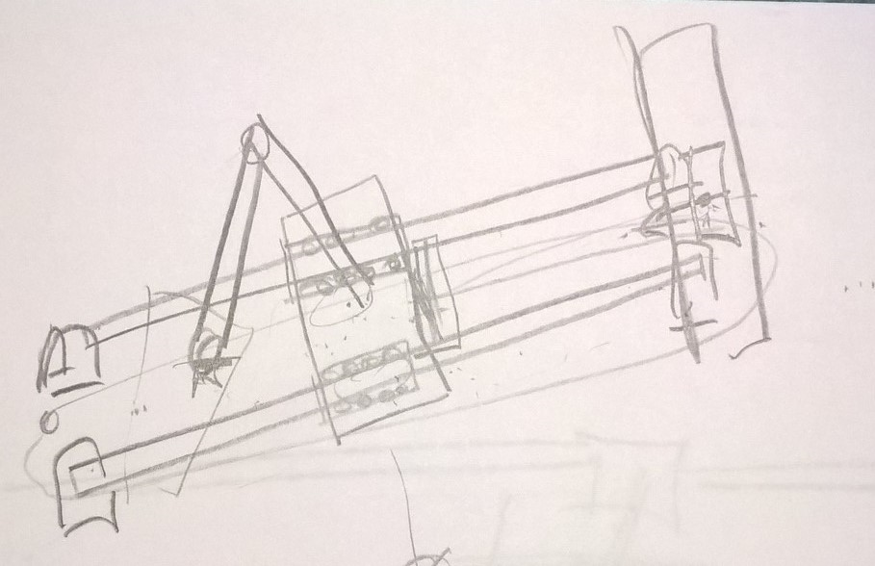
First thoughts
The robot will be constrained to movement along one axis by operating on rails.

Slide 10
Rail system advantage
Limits movement which makes it easier to determine the reward and penalty.
Locks all components of the system down for transport and demonstration.
Facilitates the construction of a controlled environment.

Slide 11
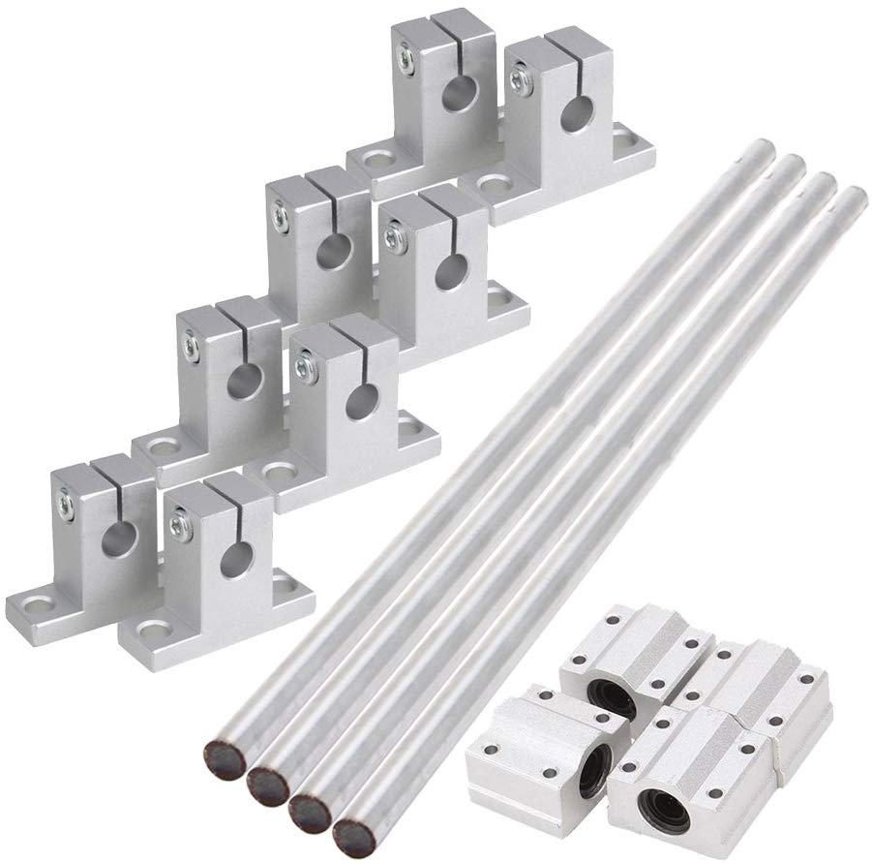
Rail Components
The rails are 300mm (about 1 foot long.) Shoebox size.
There are standoffs which allow the rails to be mounted above a fixed surface.
The rail 'trolley' contains bearings to reduce friction and surround the rod to limit any other axis movement.

Slide 12
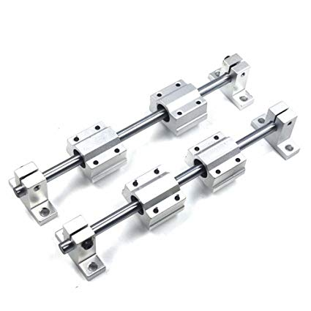
Rail Assembly

Slide 13
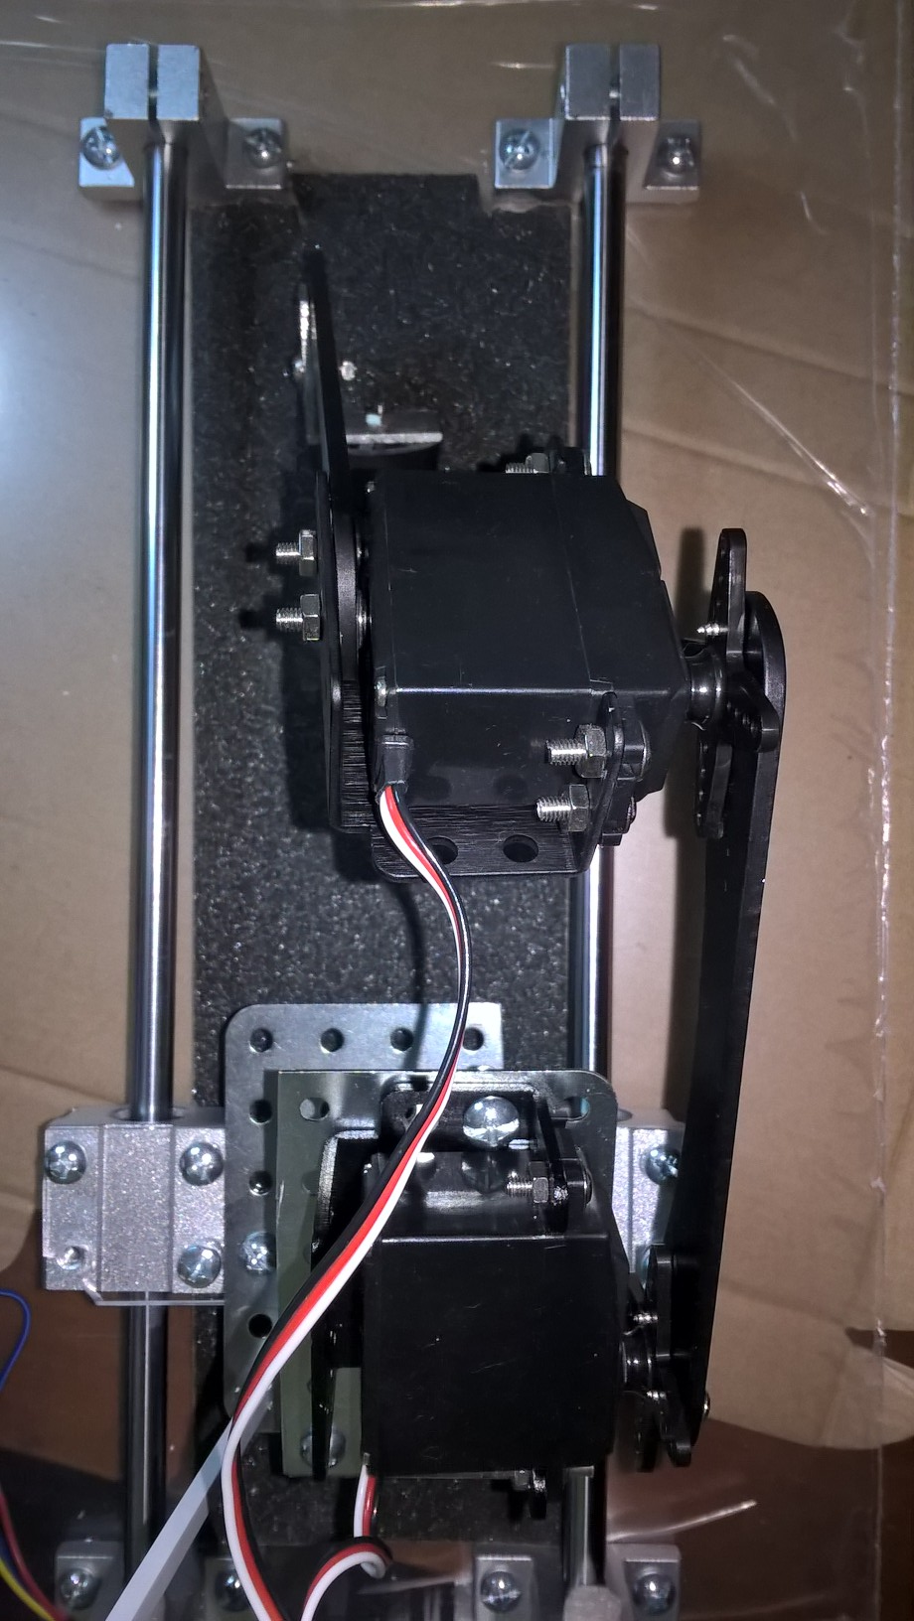
Assembly from Overhead
Crawler on Rails

Slide 14
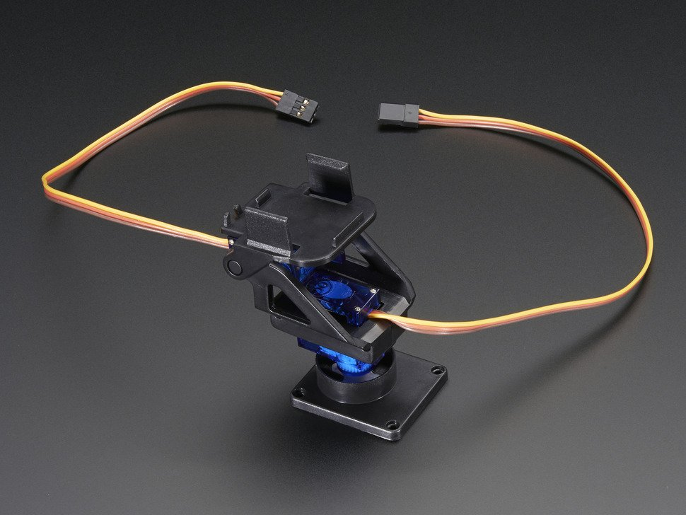
Articulating appendage
I took inspiration from camera gimble devices.

Slide 15
Servos in motion
https://www.adafruit.com/product/1967?gclid=EAIaIQobChMI4bSemoeO5wIVzJ-zCh3A0w-OEAQYAyABEgIFYfD_BwE

Slide 16
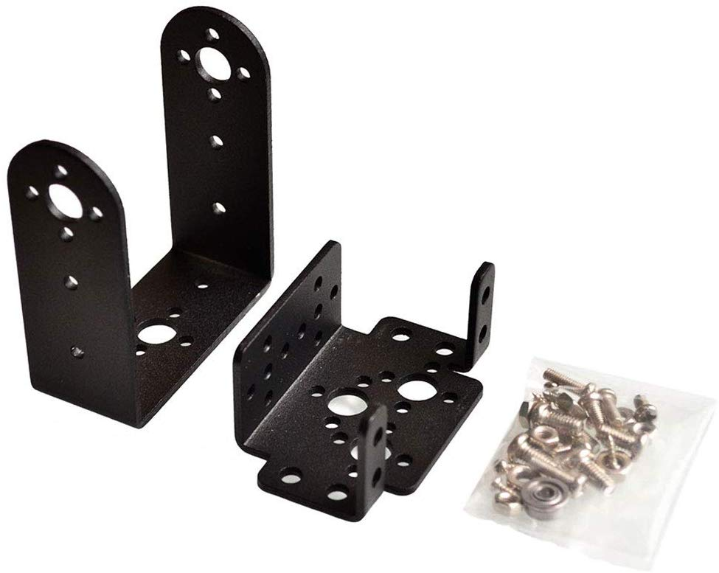
Servo Mounting brackets
High-quality and durable in performance.
The mount bracket easily attaches to MG995 996 Metal Mechanical Robot Servo

Slide 17
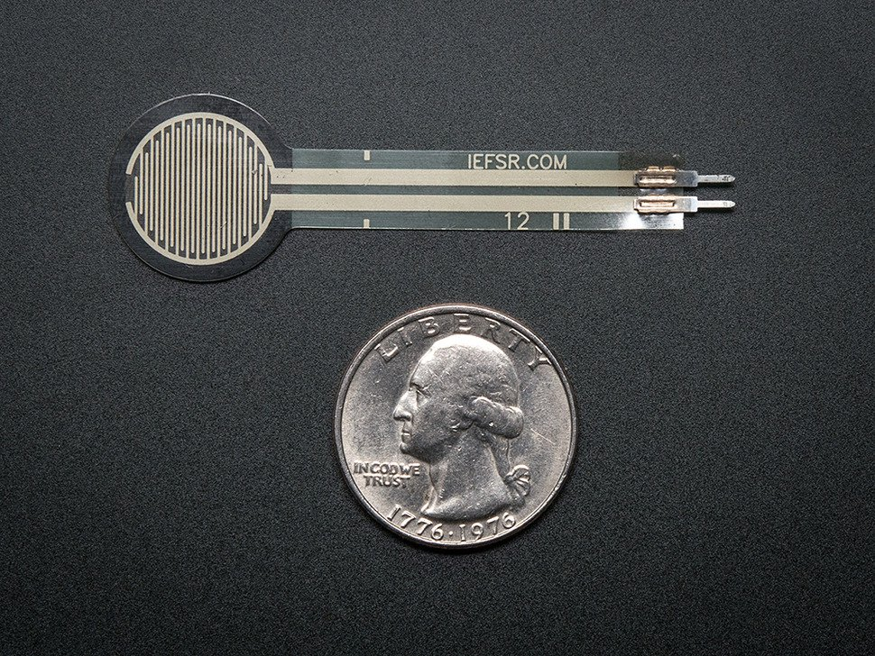
Appendage force sensor
In initial discussions with Scott we identified the need for the robot to be rewarded when the appendage touched the ground.
We will include a force sensor on the end of the 'foot'.

Slide 18
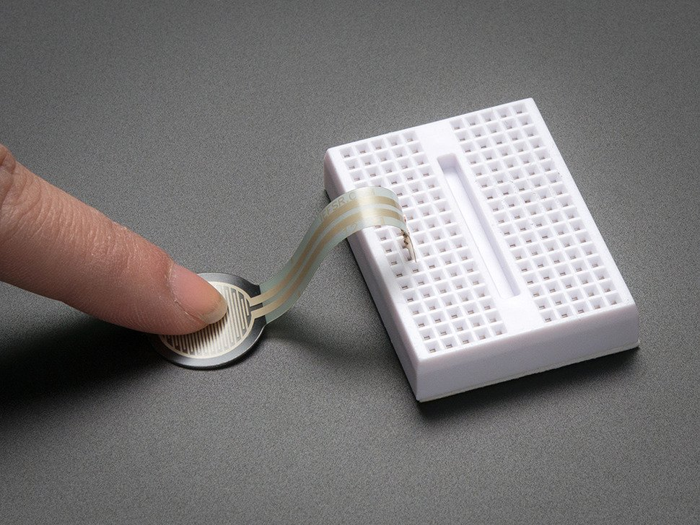
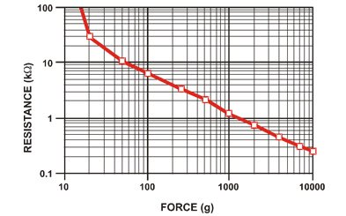
Variable resistor
FSR's are basically a resistor that changes its resistive value (in ohms Ω) depending on how much its pressed.
This will be the reward sensor.

Slide 19
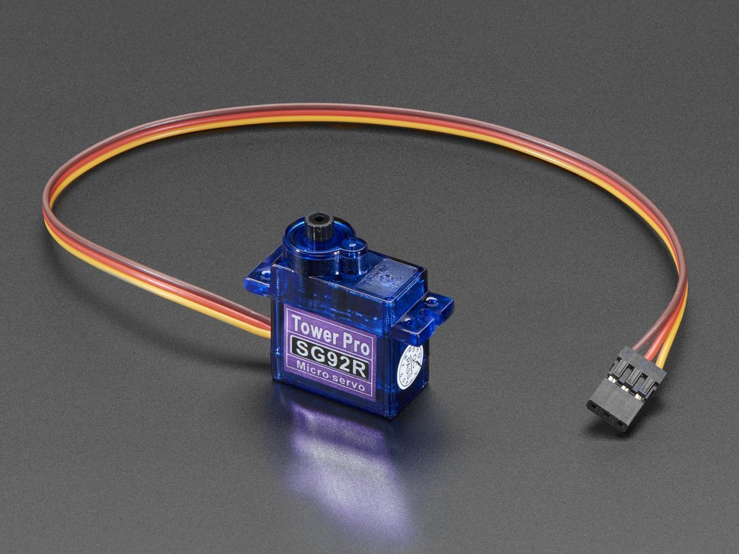
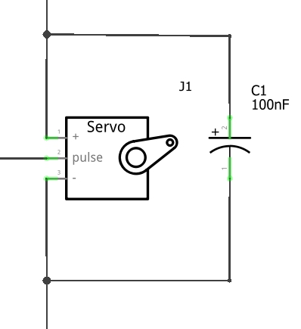
servos
The servo can rotate approximately 180 degrees (90 in each direction).
Wired with a decoupling capacitor.
Adding a decoupling capacitor allows some of the instantaneous current to come from the capacitor during servo startup instead of the power line, thus keeping the power line glitch free.

Slide 20
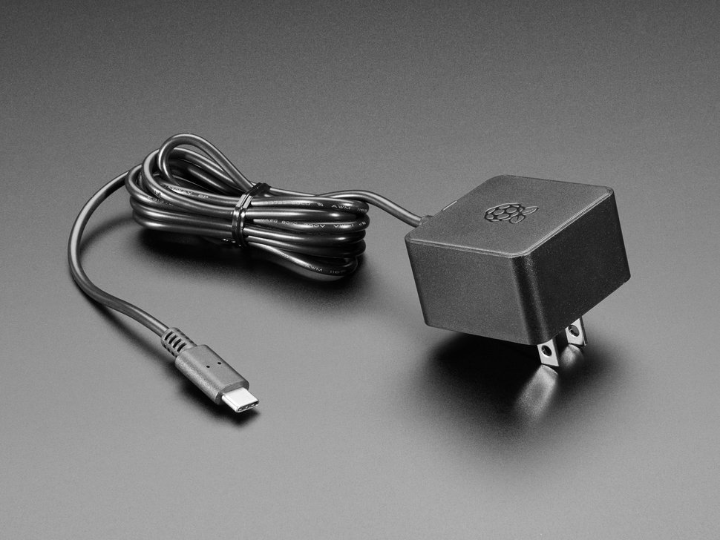
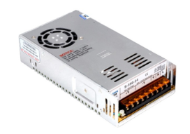
Power supply
The system will be powered from wall power so that when in 'learning mode' the system can run continuously unattended.
One power supply will be used to power the Raspberry Pi and another regulated power supply will be used for the motors.
AC supplies are specified because the training time is unknown and battery power may not last long enough.

Slide 21
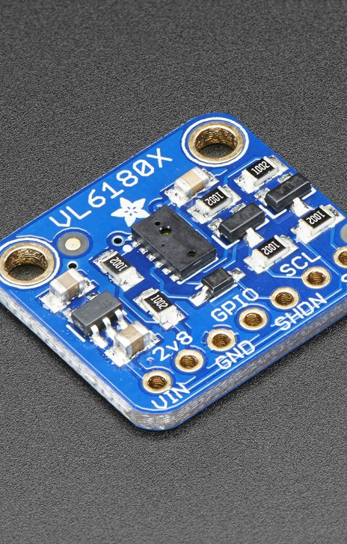
How to detect movement?
The robot is constrained to move along a track. A force sensor can be used to detect when the appendage has touched the 'ground'.
A Time of Flight Distance Sensor can be used to detect robot movement.

Slide 22
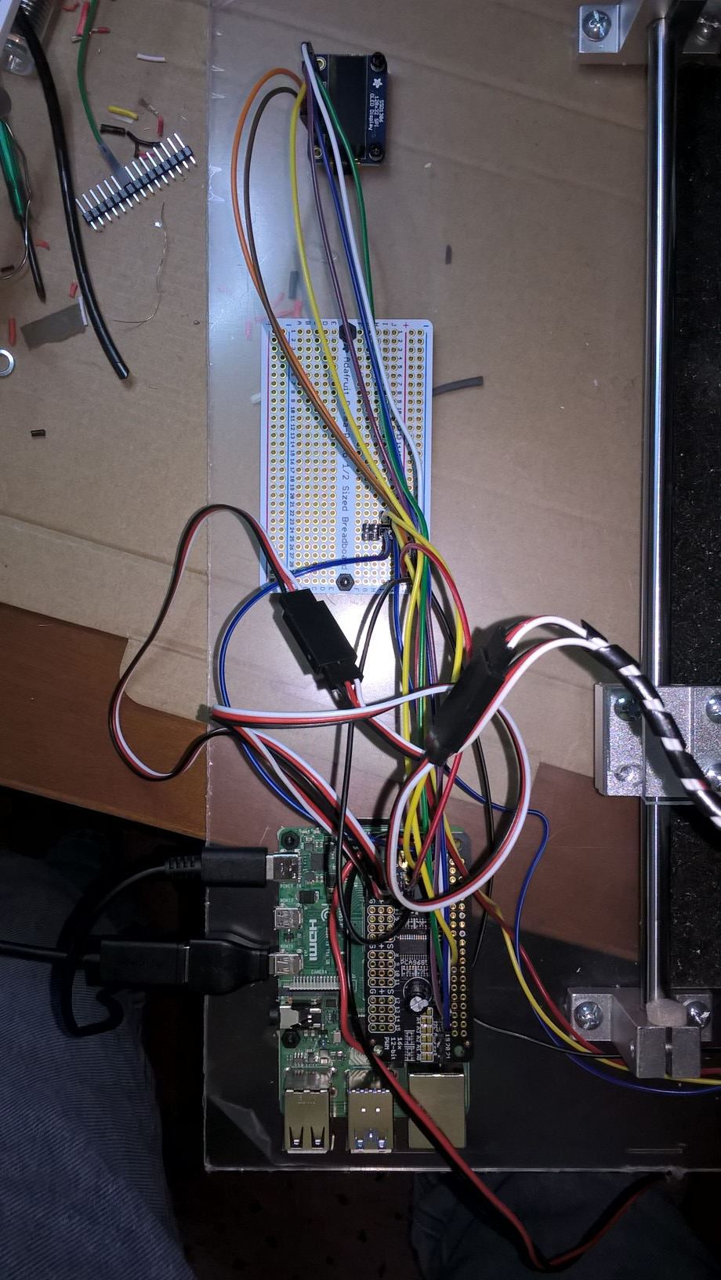
Computer, breakout and display panel
OLED Bitmap Display
Breadboard
Raspberry Pi 4

Slide 23
Time of flight sensor demonstration
https://www.adafruit.com/product/3316
The sensor contains a very tiny laser source, and a matching sensor.
The VL6180X can detect the "time of flight", or how long the laser light has taken to bounce back to the sensor. S
Since it uses a very narrow light source, it is good for determining distance of only the surface directly in front of it.

Slide 24
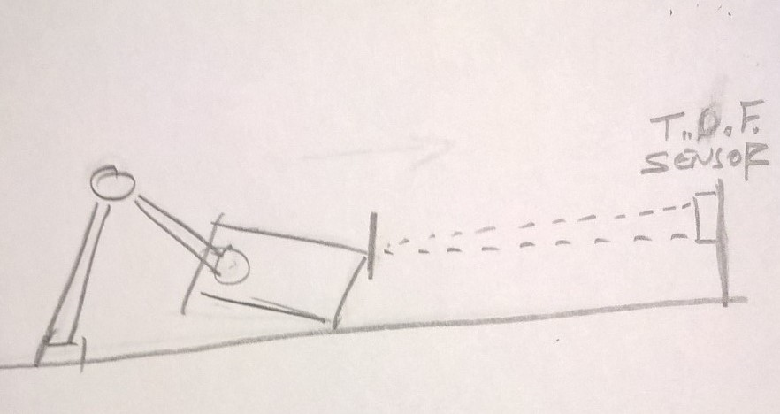
Reward Sensor
The Time Of Flight sensor will be mounted at the end of the rail system from where it will measure the position of the robot after each 'learning' instance.

Slide 25
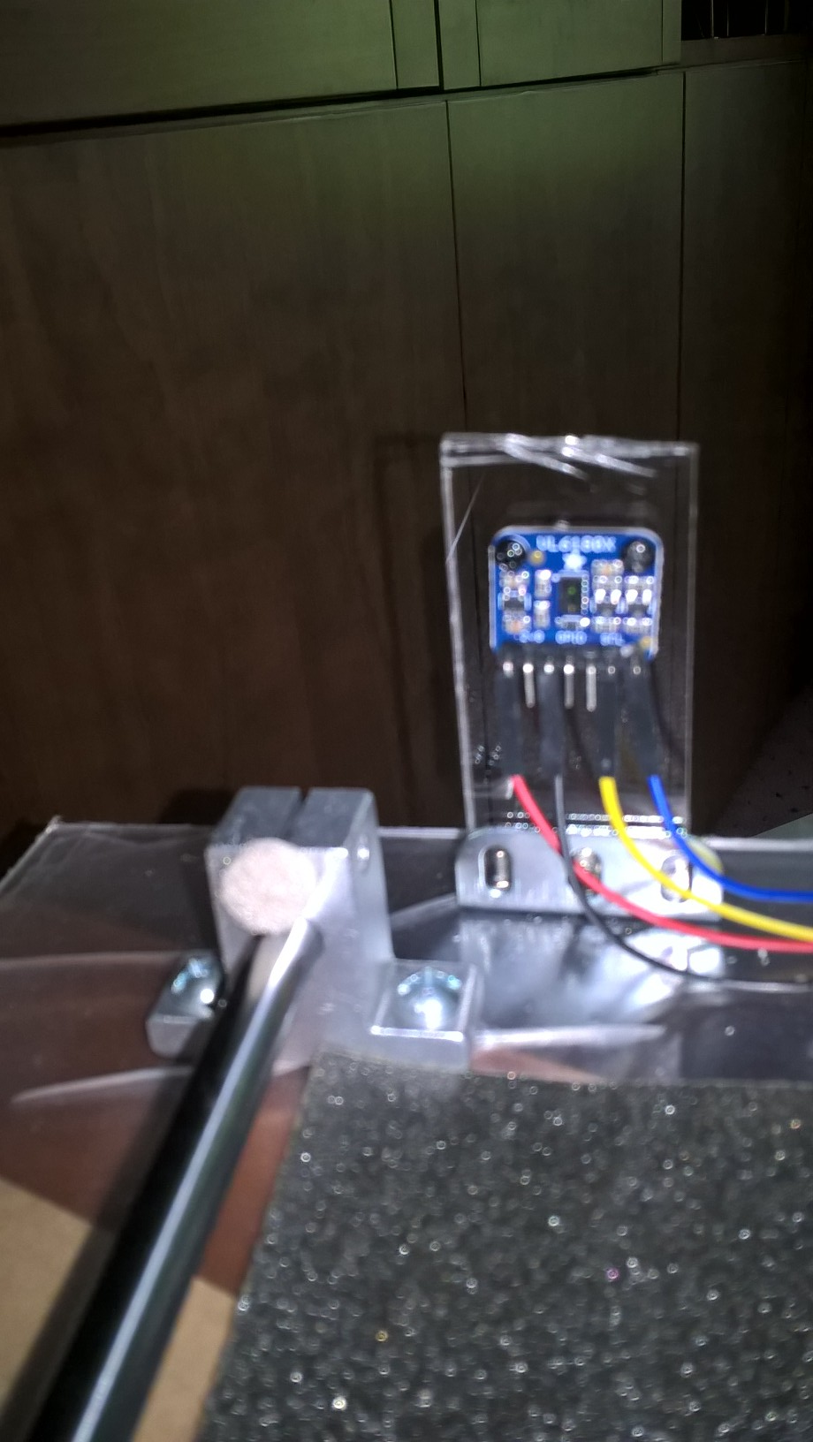
TOF sensor
The Time Of Flight sensor is mounted at the end of the crawler rail system.

Slide 26
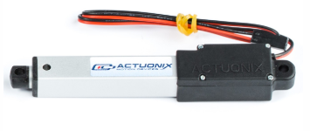
Reset
It may be necessary to include a mechanism to 'center' the robot after some number of movement attempts cause the robot to run out of room for training.
A linear actuator may be employed to move the robot back to a designated starting position during a reset operation.

Slide 27
Convergence
The T.O.F. sensor will be used to turn the robot off when it moves completely across the training field. (If the reset/centering mechanism is not available.)

Slide 28
Alternate strategy
Once the crawler reaches the end of the rail... it will begin to learn how to 'crawl' back to the starting point!

Slide 29
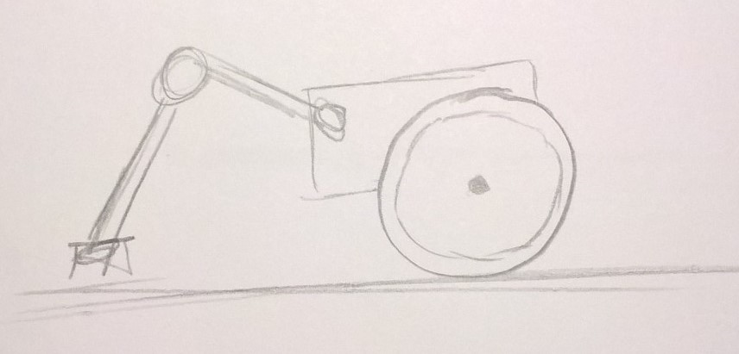
Wheeled base
Perhaps the robot can be removed from the training fixture and secured to a wheeled base to allow it to move without restriction.
NOTE: This will require the reward to be the pressure sensor.

Slide 30
Reward
Q-learning and reinforcement learning, in general terms, is about selecting an action that gives the maximum reward.
Key to the reinforcement learning process is that rewards can not be arbitrarily assigned by the environment or changed by the agent (robot) operating in the environment.

Slide 31
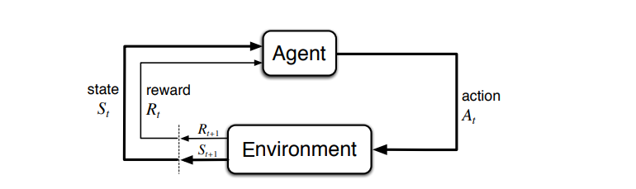
Reinforcement learning cycle

Slide 32
terms
Agent : Software program that make intelligent decisions and continues to 'learn'. The agent interacts with the environment by taking an action and receiving a reward based on the action.
Environment: Contains the demonstration of the problem to be solved.
State : The position of the agent at a specific time in the environment. Whenever an agent performs an action- the environment responds by providing the agent with a reward and a new state. State can be anything which can be useful in choosing actions.

Slide 33
Training System Components
Environment
The reinforcement learning training system. The robot sitting on a trolley between two guide rails.
State
The measurement obtained from the force sensor at the end of the appendage.
The change of distance read by the Time Of Flight distance sensor.
Action
The position of each of the appendage servos.

Slide 34
Action refined
Each servo can be programmed to one of 255 possible positions or about .7 of a degree. Considering 2 servos, this yeilds 65,536 possible states.
We can reduce the number of states by limiting each servo to 90 degrees of movement. (32,768 states)
If learning doesn't converge on a solution with this restriction, the servo precision can be further reduce to increments of 5 degrees (instead of the default .7). Resulting in 4,681 states.

Slide 35
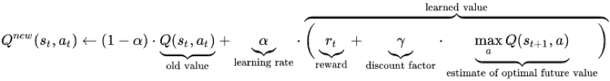
After making a move during learning, the Q value for a given state and action is replaced the new value

Slide 36
Learning rate (or Step Size)
The new value is a sum of two parts. The first part is (1-learning rate)*old value.
A learning rate of 0 will mean nothing new will be learnt.
A learning rate of 1 will mean the old value will be completely discarded.
Note: In practice a learning rate of 0.1 is a typical value.

Slide 37
Discount rate
The discount factor (gamma) determines the importance of future rewards.
A factor of 0 will make the agent "myopic" (or short-sighted) by only considering current rewards.
A factor approaching 1 will make it strive for a long-term high reward.

Slide 38
Exploration factor
The exploration are important to reinforcement learning systems. If the system keeps selecting the max reward each time, then it will keep performing the same action and will not try anything else. The system will never learn that another untried action has a better reward than this.
An exploration factor makes the algorithm select a random action a predetermined % of times.

Slide 39
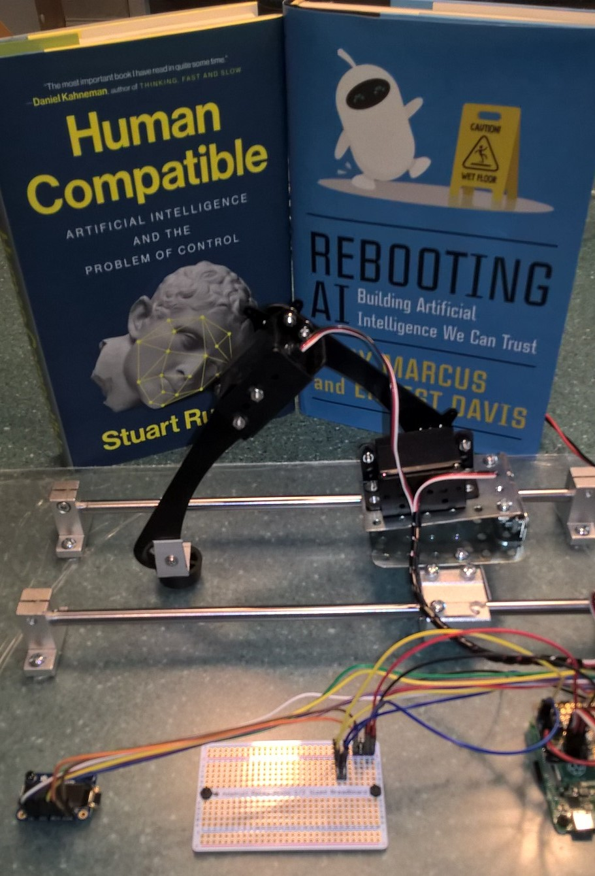
Crawler is Operational!
Even a pandemic hasn't stopped this build

Slide 40
The humans are now learning...
Firing up the crawler for the first time has revealed a few surprises.
This part of the deck is devoted to describing the lessons that we are learning.

Slide 41
A little delay, goes a long way
The crawler has a tendency to rocket backwards when it's servos are activated to move across a large angle. There is very little friction between the carriage and the rails.
When the computer simulation of the crawler is executed, there is instantaneous positioning of the arm and hand (or thigh and leg) segments.
However, in the real world, it takes time for the servo to move the segments. As such, a 100ms-200ms delay has been added to give the crawler servo's time to achieve their final position.
Much of the crawler's movement due to servo momentum has been dampened with this delay.

Slide 42
The lurching problem
"Also, the lurching backward is not something the simulator would do, so the robot will be learning a very different model than the simulator. My interpretation of the robot's movement is that the rail has low friction, so when it throws it's arm up and out, you get a conservation of momentum thing going on where the forward motion of the arm is matched by a backward motion of the chassis. So, the robot will have to figure out how to minimize this effect. This actually makes it more a more interesting problem for the robot to solve." - Scott O'Hara

Slide 43
Reward adjustment
Even with all the work to dampen the unintented movment on the rails, the crawler still moves slightly when adjusting it's servos.
The reward function has been adjusted to ignore any movement of less than 7mm.

Slide 44
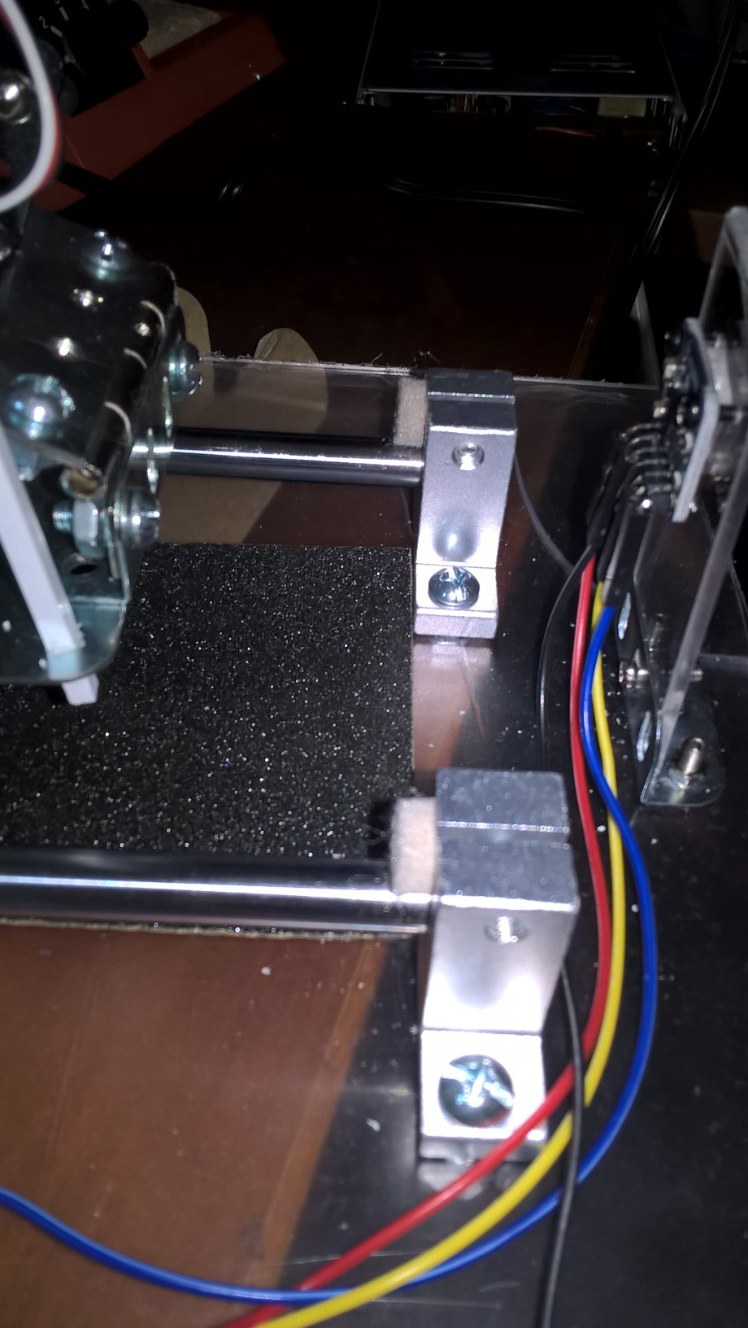
Zero position
The crawler was consistently pushing itself against the end of the rails.
Two padded bumpers were added to cushion the robot.
The Time-of-flight sensor still registers zero at this position.

Slide 45
Foot Friction
A sandpaper base was added between the tracks for the foot to grip the surface.
The Plexiglas was too slippery.

Slide 46
Wire mast
Even though the servo wires were dressed so as not to tangle in the servos- they still were getting hung up as they dragged along the bottom near the computer.
A plastic mast was added to hold the wires above the computer and rail system.

Slide 47
Reducing the state space
I have reduced the state space that the robot needs to explore.
The initial settings for the upper servo was 9 and the lower servo was 13.
There are now only 3 actions allowed for each servo.

Slide 48
Buy more servos!
I'm afraid I might burn out a servo... so I'll order some backups.

Slide 49
Programmatic crawl
At a certain point Steve Aronson asked if it was possible to write a program to instruct the servos to perform a crawling movement.
This proves that the robot and rail system environment allows a crawling motion!

Slide 50
Oscillation
When the lower servo is raised to a near vertical position, any motion of the upper servo causes the crawler to rock back to the 'zero' position.
Limit the lower servo to 50 degrees of freedom (from 90 degrees)

Slide 51
Smooth moves
When the crawler moves through a reduced action state space (3x3), the angle that each servo has available is greater than that when the

Slide 53

Thank You
Metrowest boston developers machine learning group

